Slide 1


Interactive 3D Tool Analysis
HCI vs. Computer Graphics Visual Evaluation
Student Name MUHAMMAD NOMAN
Roll Number 2K24/CSE/105
An academic comparative case study demonstrating the fundamental distinctions between Human-Computer Interaction (interaction affordances, input design, visual feedback) and 3D Computer Graphics (mesh geometry, texture mapping, lighting cues) using Google Earth 3D.
Subject HCI & COMPUTER GRAPHICS
Submitted To MR. RAJESH KUMAR
Target Interactive 3D Platform: Google Earth Web (3D Canvas)
Assignment: Visual Annotation & Analysis of an Interactive 3D Digital Tool
Slide 1 of 8

Slide 2


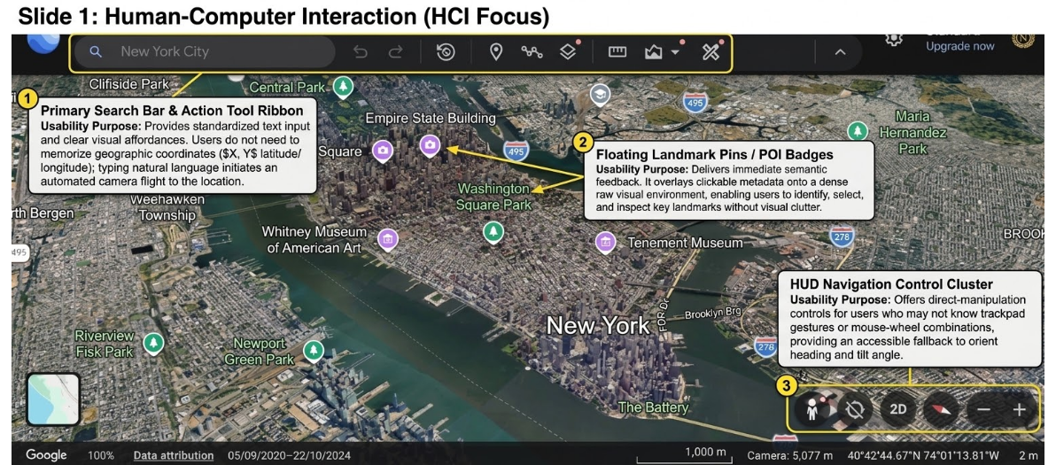
Slide 1: HCI Focus — Manhattan & Hudson River
Annotations: (1) Primary Search Bar & Action Ribbon | (2) Floating Landmark Pins / POI Badges | (3) HUD Navigation Control Cluster
Slide 2 of 8

Slide 3



HCI Element Analysis & Usability Purpose
Primary Search Bar & Action Tool Ribbon
Floating Landmark Pins / POI Badges
HUD Navigation Control Cluster
"New York City" Search + Tool Icons
Times Square & Empire State Badges
Compass, 2D/3D, Pegman & Zoom (+/−)
Usability Purpose: Provides standardized text input and clear visual affordances. Users do not need to memorize geographic coordinates (X, Y latitude/longitude); typing natural language initiates an automated camera flight to the location.
Usability Purpose: Delivers immediate semantic feedback. It overlays clickable metadata onto a dense raw visual environment, enabling users to identify, select, and inspect key landmarks without visual clutter.
Usability Purpose: Offers direct-manipulation controls for users who may not know trackpad gestures or mouse-wheel combinations, providing an accessible fallback to orient heading and tilt angle.
Fulfills Requirement: 3 interaction elements identified with usability justification
Slide 3 of 8

Slide 4
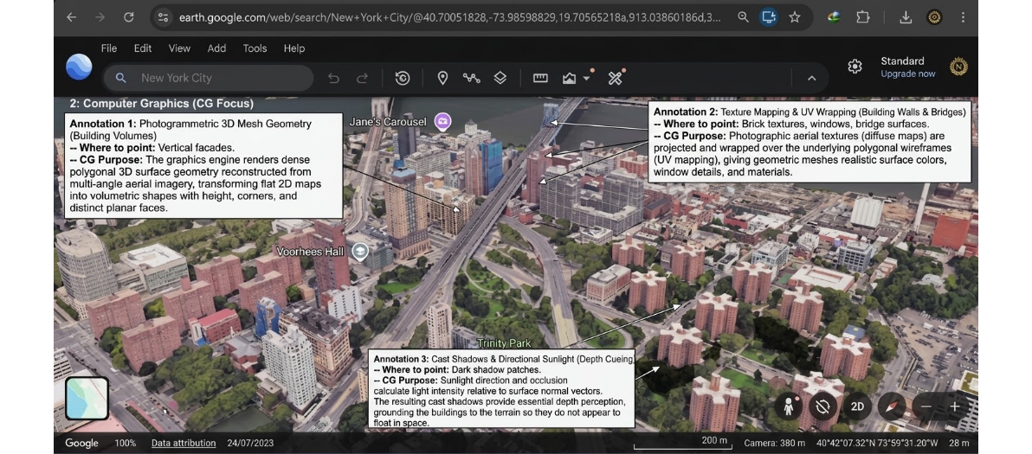
Slide 2: Computer Graphics Focus — Brooklyn 3D Close-Up
Annotations: (1) Photogrammetric 3D Mesh Geometry | (2) Texture Mapping & UV Wrapping | (3) Cast Shadows & Directional Sunlight
Slide 4 of 8

Slide 5
CG Element Analysis & 3D Space Construction
Photogrammetric 3D Mesh Geometry
Texture Mapping & UV Wrapping
Cast Shadows & Directional Sunlight
Vertical Facades & Building Volumes
Brick Textures, Windows & Roadways
Ground Shadow Patches at Building Bases
CG Purpose: The graphics engine renders dense polygonal 3D surface geometry reconstructed from multi-angle aerial imagery, transforming flat 2D maps into volumetric shapes with height, corners, and distinct planar faces.
CG Purpose: Photographic aerial textures (diffuse maps) are projected and wrapped over the underlying polygonal wireframes (UV mapping), giving geometric meshes realistic surface colors, window details, and materials.
CG Purpose: Sunlight direction and occlusion calculate light intensity relative to surface normal vectors. The resulting cast shadows provide essential depth perception, grounding the buildings to the terrain so they do not appear to float in space.
Fulfills Requirement: 3 rendering elements identified explaining how they create 3D space
Slide 5 of 8

Slide 6


Step 3: Reflection 1, CG Quality vs. Interactivity
REFLECTION QUESTION 1
How does the Computer Graphics quality help or hinder the user's ability to interact with the software?
How Computer Graphics Quality Helps
How Computer Graphics Quality Hinders
High-quality 3D graphics, realistic lighting, and shadows help users understand the environment and navigate the software more easily. Clear buildings, roads, and terrain improve spatial awareness and make interaction more intuitive.
Very detailed graphics can create visual clutter and make some objects difficult to recognize. Complex rendering can also cause lag on slower devices, making navigation and interaction less responsive.
Connects real-time computer graphics rendering fidelity directly to uability and mental models
Slide 6 of 8

Slide 7


Step 3: Reflection 2, Proposed HCI Improvement
REFLECTION QUESTION 2
What is one simple HCI change you would make to improve the user interface?
Proposed Solution: Layer Transparency Slider & Hotkey
Add a quick-access on-screen slider or hotkey to adjust layer transparency and hide distracting labels or pins, giving users a clearer and more focused view of the 3D environment.
HCI PRINCIPLE INVOLVED
COGNITIVE ERGONOMICS
User Control & Freedom: Provides reversible visibility modes without digging through nested setting menus.
Selective Visual Attention: Eliminates perceptual interference when users explore photogrammetric architectural geometry.
Concrete UI improvement balancing informational utility with clean visual exploration
Slide 7 of 8

Slide 8
Assignment Summary
Component | Requirement | Status & Slide
HCI Annotation | Correctly identifies 3 interaction/UI elements and their usability purpose | Fully detailed on Slide 2 & 3 (Search ribbon, POI pins, HUD cluster)
CG Annotation | Correctly identifies 3 graphics/rendering elements (light, mesh, texturing) | Fully detailed on Slide 4 & 5 (3D meshes, UV wrapping, cast shadows)
Reflection | Clear, concise answers connecting graphics rendering to user experience | Addressed on Slide 6 & 7 (Mental models vs. clutter, declutter slider)
Clarity & Layout | Clean screenshot layout with easily readable callouts and pointers | High-contrast presentation with labeled images
MUHAMMAD NOMAN (2K24/CSE/105)
Department of Computer science
Slide 8 of 8

